Slide 1
ABC District
Next Generation Accountability Report
2021-22
Fall 2022
Notes:
This is an editable PowerPoint prepared by the CSDE for districts to use at local board of education or other district/school meetings.
Slides can be added or deleted as needed.
We encourage customization to your local context.

Slide 2
Accountability Systems Serve Important Purposes
Track progress
Help schools and districts make improvements
Show where support is needed most
Recognize successes
Promote transparency
Satisfy federal and state requirements

Slide 3
Connecticut Next Generation Accountability System for Districts and Schools
Provides a more complete picture of a school or district
Guards against narrowing of the curriculum to the tested subjects
Expands ownership of accountability to all staff
Allows schools to demonstrate progress on “outcome pre-cursors”
Encourages leaders to view accountability results not as a “gotcha” but as a tool to guide and track improvement efforts
Developed by CT Department of Education with extensive feedback from district and school leaders, Connecticut educators, state and national experts, CSDE staff, and many others.
Notes:
A student is more than a test score and school or district is more than the average of those scores.
Focusing on a broader set of indicators will guard against narrowing of the curriculum to what’s tested.
It will also make more local practitioners see their contributions reflected in the accountability system.

Slide 4
What are the 12 Indicators?
Academic achievement (Performance Index) ^{H}
Academic growth ^{H} and Progress toward English proficiency
Assessment participation rate ^{H}
Chronic absenteeism ^{H}
Postsecondary preparation
Postsecondary readiness
Graduation – on track in ninth grade
Graduation – four-year adjusted cohort
Graduation – six-year adjusted cohort ^{H}
Postsecondary Entrance Rate
Physical fitness
Arts access
  ^{H} Separate set of points allotted for “High Needs” (students from low-income families, English learners (ELs), or students with disabilities)

Slide 5
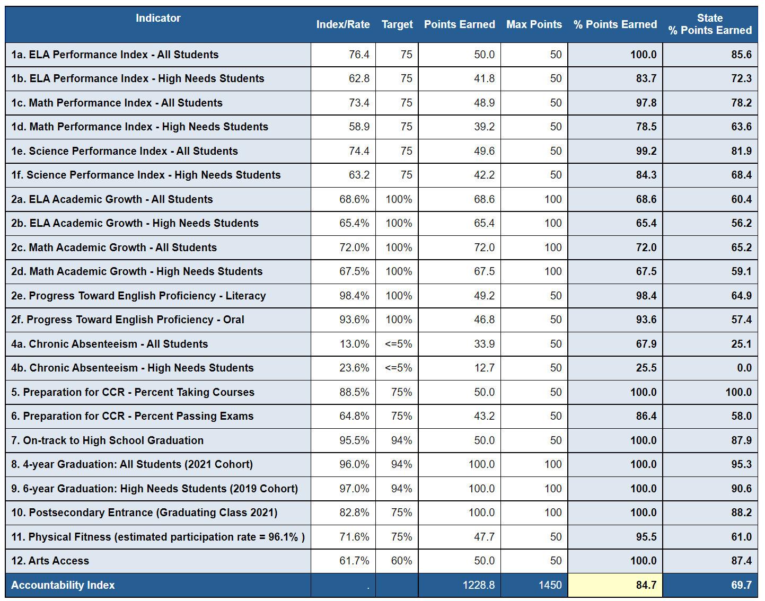
ABC District Report: 2021-22
Indicator 3 is the participation rate.
Notes:
Key Terms:
The percentage of total possible points earned on all indicators is the “Accountability Index”.
“Performance index” (SPI/DPI) will continue to refer to the index scores derived from state assessment results (Indicator 1). Note that only subject indexes are provided.
These terms are defined in Sec. 326 of Public Act 15-5.
Refer to the document “Using Accountability Results to Guide Improvement” for the methodology for each indicator.

Slide 6
ABC District Report: 2018-19 to 2021-22
Change between ±1 percentage point is indicated as
Notes:
Replace the 2018-19 and 2021-22 Percentage of Points Earned with the values for your own district.
Increase of 1 percentage point or greater is indicated with an up arrow.
Decrease of 1 percentage point of greater is indicated with a down arrow.
Changes between ±1 percentage point is indicated with a sideways arrow.

Slide 7
Achievement and Graduation Rate Gaps
A district/school is identified as having an “achievement gap” if its gap size is substantially different from the average statewide gap in any subject area
A district/school is identified as having a “graduation gap” if its gap size is substantially different from the average statewide gap

Slide 8
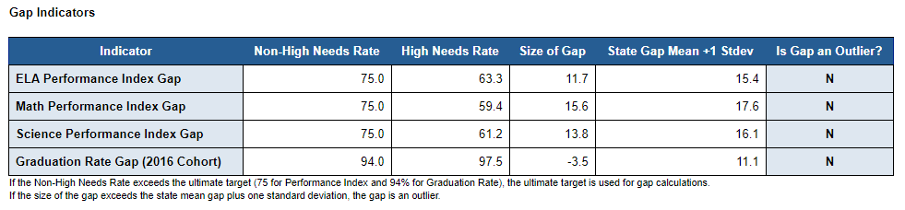
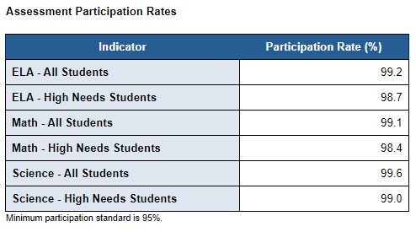
ABC District Report, 2021-22 (continued)
Notes:
A district’s gap size is the difference in “performance index” or six-year graduation rate between the Non-High Needs group of students, and students with High Needs.
Every school and district is expected to meet the 95% participation rate standard for the ALL Students group and the High Needs student group in ALL the tested subject areas (i.e., English Language Arts, Mathematics, and Science).

Slide 9
ABC District Schools Report, 2021-22
School Name | Accountability Index | Any Participation below 95%? | Achievement Gap? | Graduation Rate Gap? | Category
XYZ Elementary School | 77.3 | No | No | No | 2
DEF Intermediate School | 65.4 | No | No | No | 3
MNO High School | 71.2 | Yes | No | Yes | Category 4: Focus ELA

Slide 10
ABC District: Needs Assessment
 | Strengths | Opportunities
Academics: Design and implement a rigorous and engaging academic program that allows all students to achieve at high levels, including aligned curricula, instruction, and assessments
Talent: Employ systems and strategies to recruit, hire, develop, evaluate, and retain excellent school leaders, teachers, and support staff.
Notes:
Insert the districts’ strengths and opportunities from the most recent needs assessment.

Slide 11
ABC District: Needs Assessment
 | Strengths | Opportunities
Culture and Climate: Foster a positive learning environment that supports high-quality teaching and learning, and engages families and the community as partners in the educational process.
Operations: Create systems and processes that promote organizational efficiency and effectiveness, including through the use of time and financial resources.
Notes:
Insert the districts’ strengths and opportunities from the most recent needs assessment.

Slide 12
ABC District Strategic Priorities
Notes:
Insert the districts’ strategic priorities.

